Slide 1
Assisting Peers to Provide Worthwhile Feedback
UC Merced
SATAL Program
Notes:
Pre and post test; sign in sheet; dry erase markers; flawed email

Slide 2
As SATAL Students...
We frequently collect class feedback while conducting focus groups, class interviews or course evaluations.
The goal is to share the student perspective with instructors
Notes:
Our main task is to collect student perspective that we can provide to instructors for their benefit. It is paramount to collect accurate and detailed data that will be helpful to instructors.

Slide 3
Learning Outcomes
By the end of this workshop, you will be able to:
give valuable feedback
identify methods of giving feedback

Slide 4
Activity: Pre-test
Please offer feedback to your “roommate” on their email.
You have 3 minutes.
Use only the left “pre-test” column.
Notes:
Your roommate has to send out a formal email, to a professor asking for a letter of recommendation. He/she asks you for your feedback on it, being the nice roommate you are, you say yes. Now provide feedback for their email.

Slide 5
What are some situations when constructive feedback is necessary?
Someone asks your opinion about how they are doing
Peer reviews
Ongoing performance discussions
Course evaluations
Providing specific performance pointers
Group work feedback
Concern about a peer’s work habits
Peer conversation
Notes:
Providing constructive feedback is essential for group activities and communication amongst others. It creates a more comfortable environment and it prevents any social miscalibration within a group.

Slide 6
Thanks for completing
We need to ensure feedback is valuable and helpful so we can get the message to the friend, instructor, or classmate
Too often we get feedback that is non-constructive

Slide 7
For example
“This class is too early.”

Slide 8
An early class can be an issue but...
The feedback isn’t related to teaching and learning
It does not offer a solution or a suggestion
The class schedule is not under the instructor’s control
Notes:
There are several ideas to keep in mind when providing feedback to instructors. Does the feedback apply to them and if so, what are some possible solutions to the feedback?

Slide 9
Remember
Peer feedback gives the opportunity to tune instruction to the students’ perspective (learner-centered) to enhance learning environments

Slide 10
Feedback can be valuable and helpful!

Slide 11
Benefits of peer review include:
Having another person’s perspective
Learning by explaining to others
Critically reflecting on own work
Discussion to help organize an argument
Notes:
Knowledge of your peer’s perspective will provide new ideas and options that can be built upon for a better outcome. Providing feedback can also help you maintain the important information of your own writing piece.

Slide 12
Take a moment to reflect on peer review experiences
Have you participated in peer reviews for class?
Was it positive? Negative?
Have you ever been trained to provide constructive feedback?

Slide 13
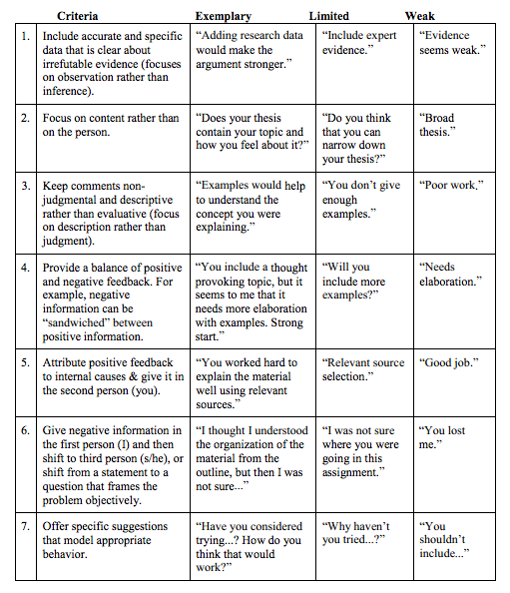
The purpose of a rubric is...
To describe expected product
To provide criteria for levels of performance
To outline how to reach goals of the task
Notes:
Rubrics are great for providing an overview of what needs to be done and the goals that must be completed for the best outcome possible.

Slide 14
The rubric for giving constructive feedback is...
Designed to help peers and faculty give valuable feedback to each other
We hope you will be able to give constructive feedback with help from the rubric

Slide 15
FEEDBACK is valuable and useful when…
Notes:
Feedback is valuable and useful when… We’re going to explain the who, why, what, and how of providing feedback

Slide 16
(WHO) Someone provides it with the appropriate audience in mind
Who is going to receive this information: a peer, an instructor, the program director?

Slide 17
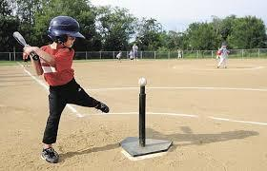
(WHEN) It is given as soon as possible after performance
And allows for response and interaction
Will the feedback still be relevant to the audience?
Notes:
The when aspect of providing feedback is just as important as the other four W’s. Depending on what’s being evaluated, if more than several days passes before the feedback is given, then that feedback may lose credibility and relevance to the receiver. Providing the feedback ASAP allows the receiver to effectively work with the comment in their current work.

Slide 18
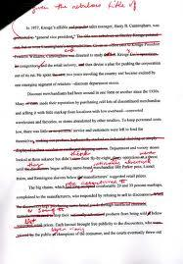
(WHY) There is purpose awareness
What is my audience going to do with this information: make changes in the draft, adjust teaching strategies, add a class to the program?

Slide 19
(WHAT) It is focused
And provides specific information with clear evidence of appropriate content
What are the goals? What progress is being made toward those goals? What activities will lead to better progress?
Notes:
The content of the feedback should only address the work that is being evaluated and not target the receiver directly. Focusing on the work prevents any hostility and social miscalibrations between both parties.

Slide 20
(HOW) It is perceived as well-intentioned, respectful and knowledgeable
Is what I’m saying specific and useful to the audiences? Am I addressing the content in a focused, constructive and respectful manner?

Slide 21
Rubric
criteria explained:
Notes:
Rubric criteria explained...

Slide 22
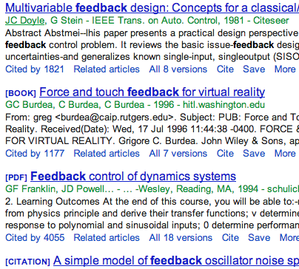
(1) Include accurate and specific data that is clear about irrefutable evidence
Example: “Adding expert evidence, like data from research articles, will help make your argument much stronger.”

Slide 23
(2) Focus on the content rather than the person
Notes:
When providing negative feedback, one must use first or third person syntax to prevent judgemental comments. Forming negative feedback in a form of a question is just as effective too.

Slide 24
(3) Comments should focus on description, not judgement
Comments should be..
Non-judgemental
Descriptive
Specific
Be honest, but respectful. Remember, the goal is to help the person improve.

Slide 25
(4) There should be a balance between positive and negative feedback
One way to do this is to sandwich negative data between positive data
Knowing what to keep is important
Notes:
Helps to tell what people should keep, not only what we might think should change.

Slide 26
(5) Positive feedback is attributed to internal causes and given in the second person
Start sentences with, “You…” “You used very supportive examples.”

Slide 27
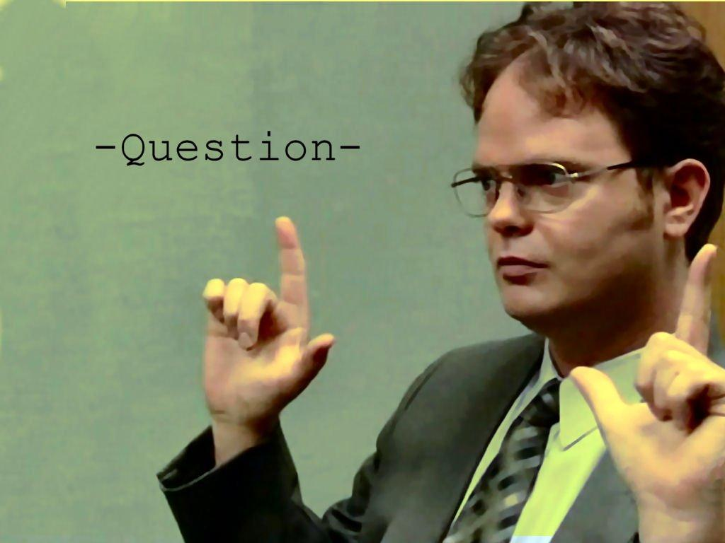
(6) Negative feedback should be given in the first person (I), then the third (you)
Start sentences with, “I had a lot of questions in the introduction,” “I was unsure what was meant here because...”
Notes:
Once again, if one doesn’t use first or third person syntax for negative feedback, then there is a potential chance that the receiver may feel in the wrong or unsettled with their own work. First and third person allows the receiver to feel motivated to better themselves and know that their mistakes are part of the refining process.

Slide 28
(7) Offer specific suggestions that model appropriate behavior
“This type of example might support your argument…”
“Have you considered introducing this concept first?”

Slide 29
Activity: Post-test
Put your new knowledge to the test!
Revise your previous feedback for the email and offer constructive feedback using the rubric
You have 5 minutes

Slide 30
Share Feedback Examples
Share
Notes:
Share the improvement on the feedback

Slide 31
Thank You!

