Slide 1
Writing 001 First Day
with Ms. Ayik

Slide 2
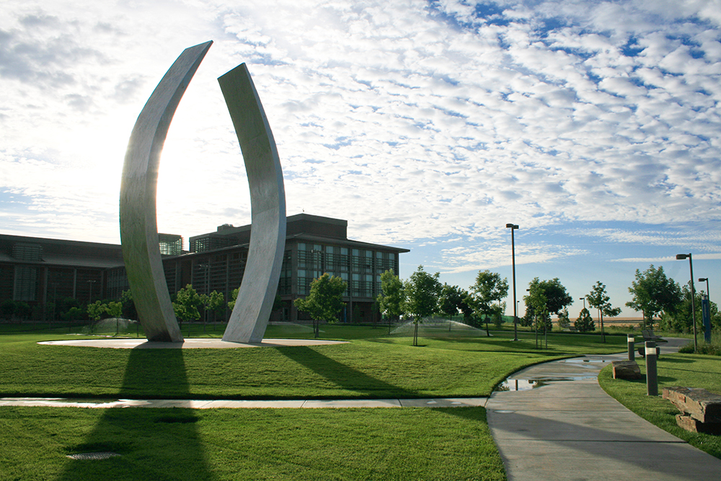
Welcome Students!
Today’s Lessons:
Introductions to each other and the syllabus.
Time Management, Goal Setting, and Procrastination
Objectives:
-Familiarize yourself with course syllabus.
-Establish short term, intermediate, and long-range goals.
-Learn three tools for time management
-Understand what procrastination is, why we do it, and what we can do to stop it.

Slide 3

Interviews
You will interview and then present your partner to the class.
Pair up.
Generate a creative interview question in your group. This question should not be one of the following which you will ask anyway:
What is your full name, and what do you want to be called?
Where are you from?
What is your major? (if unknown, do they prefer math and science or people studies, like psychology or history?

Slide 4

Syllabus Discovery
Use the syllabus Part I to fill out the handout.

Slide 5
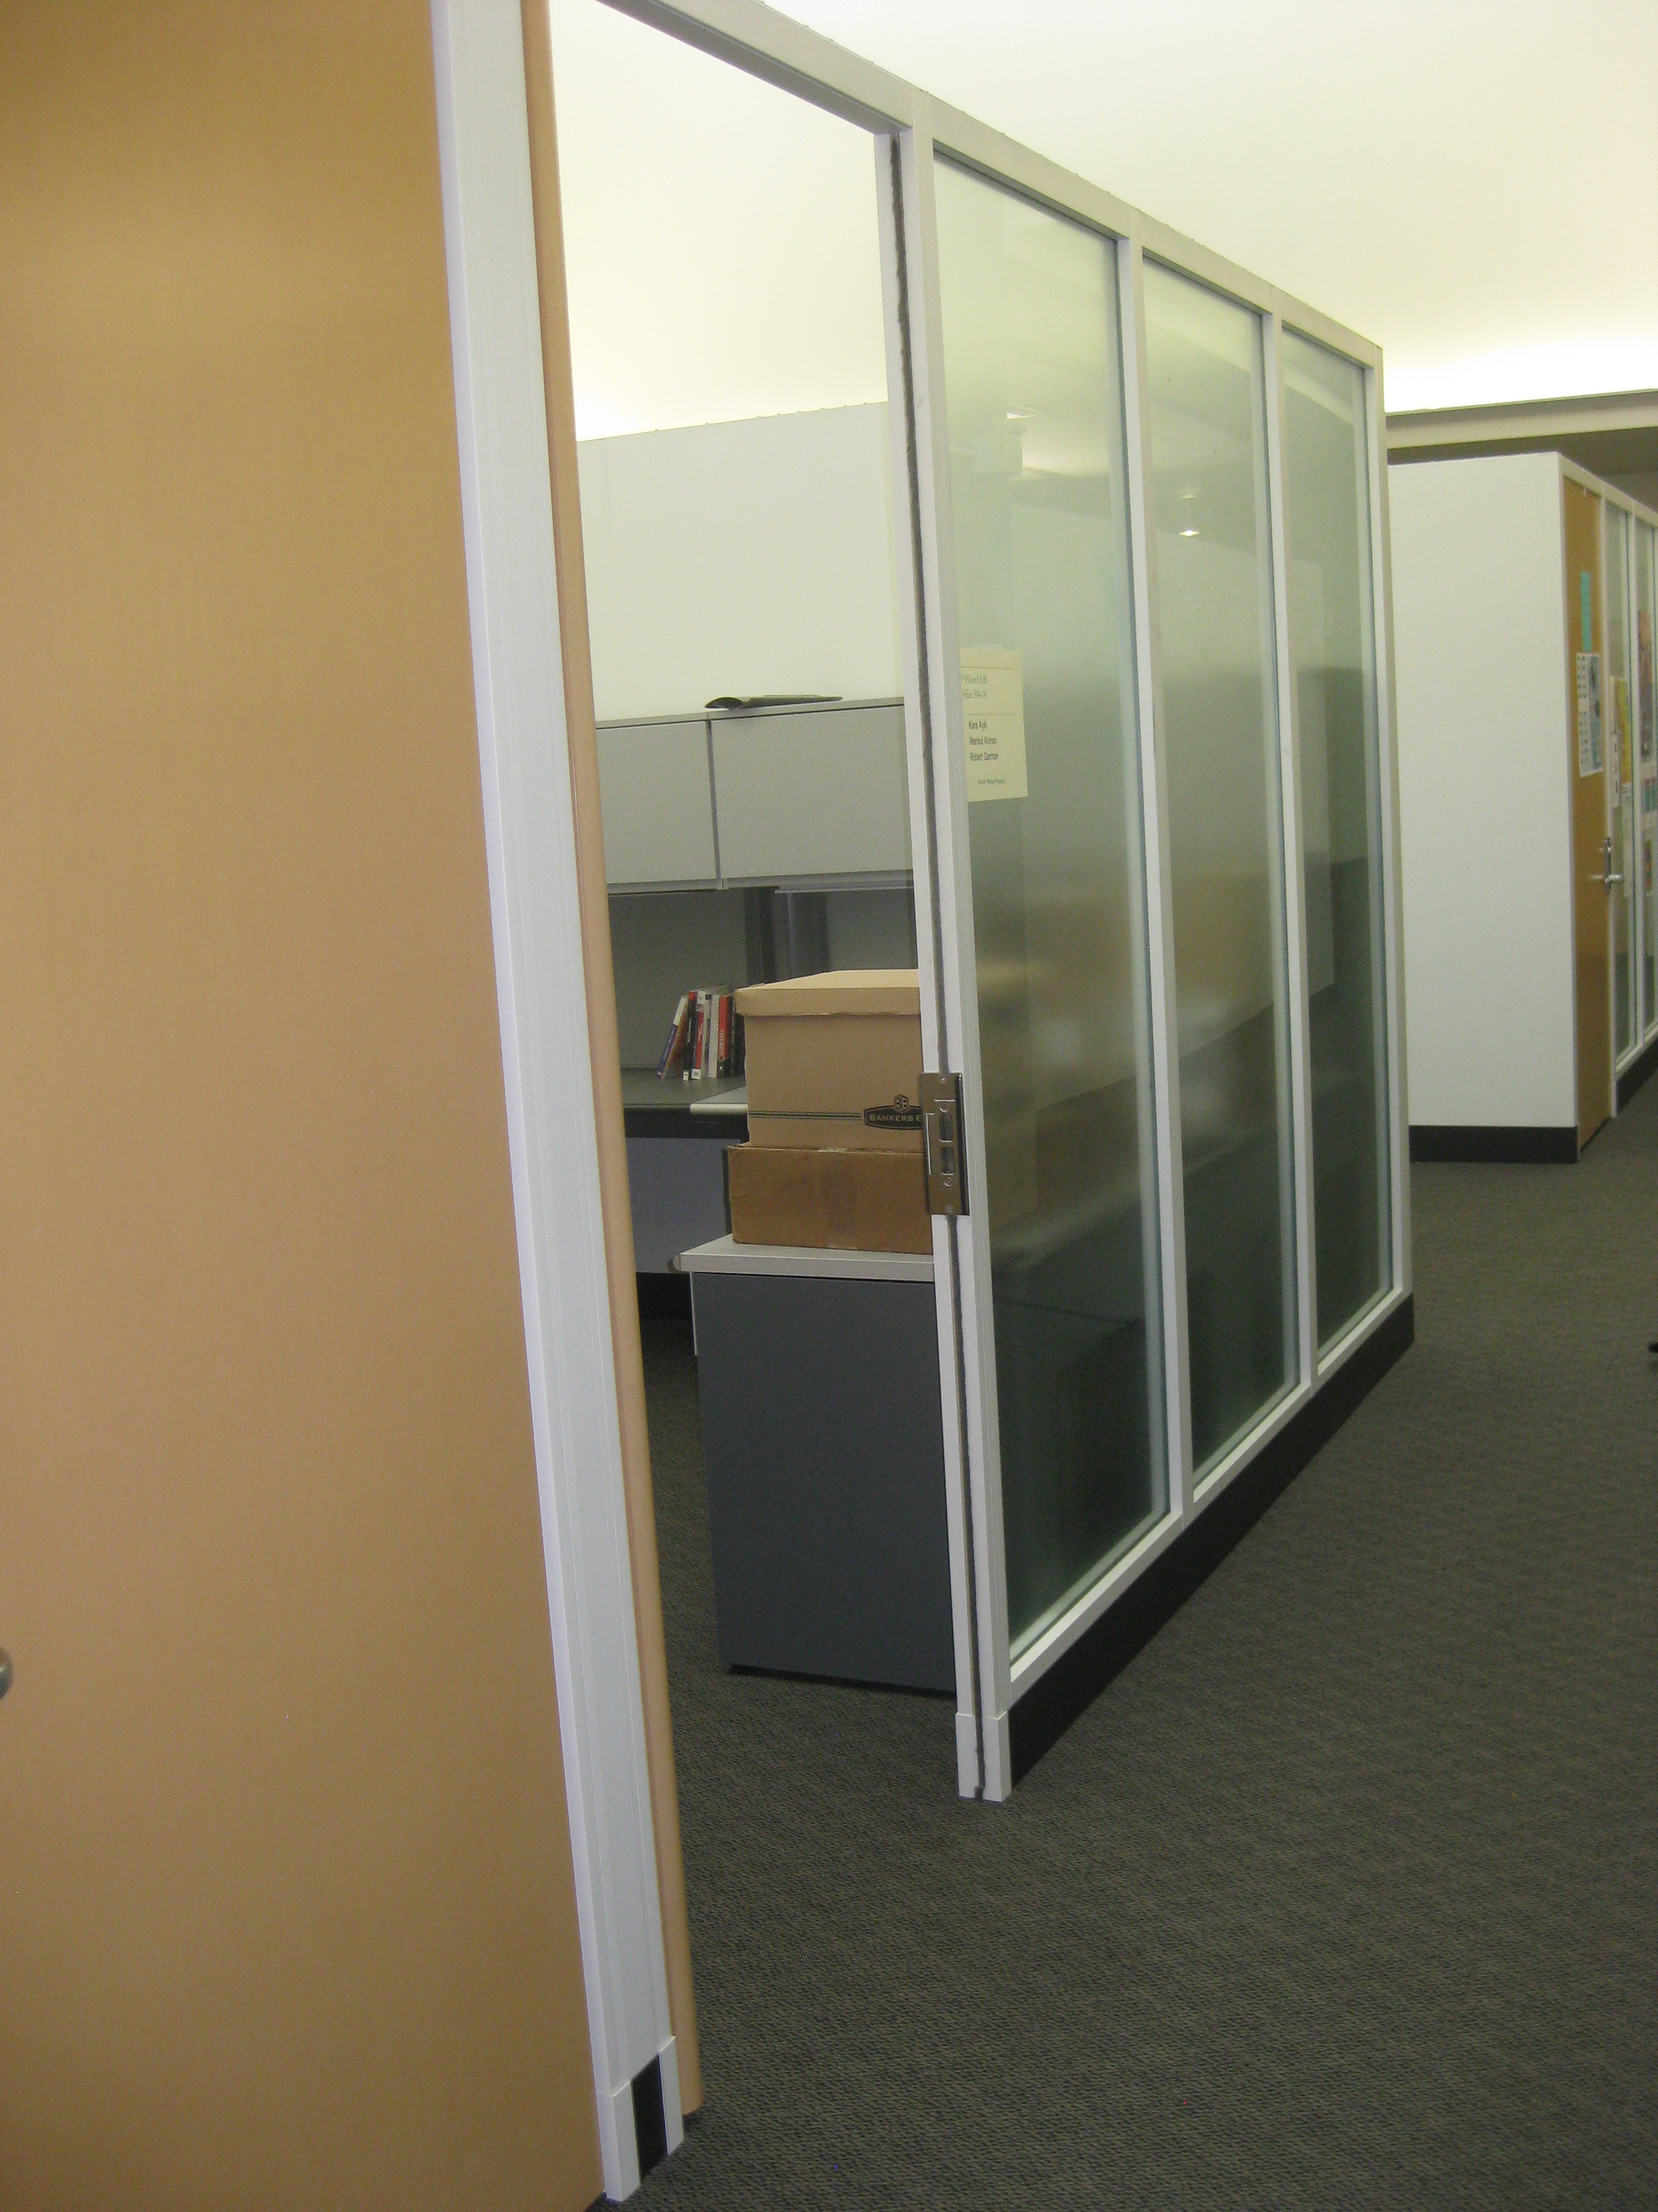
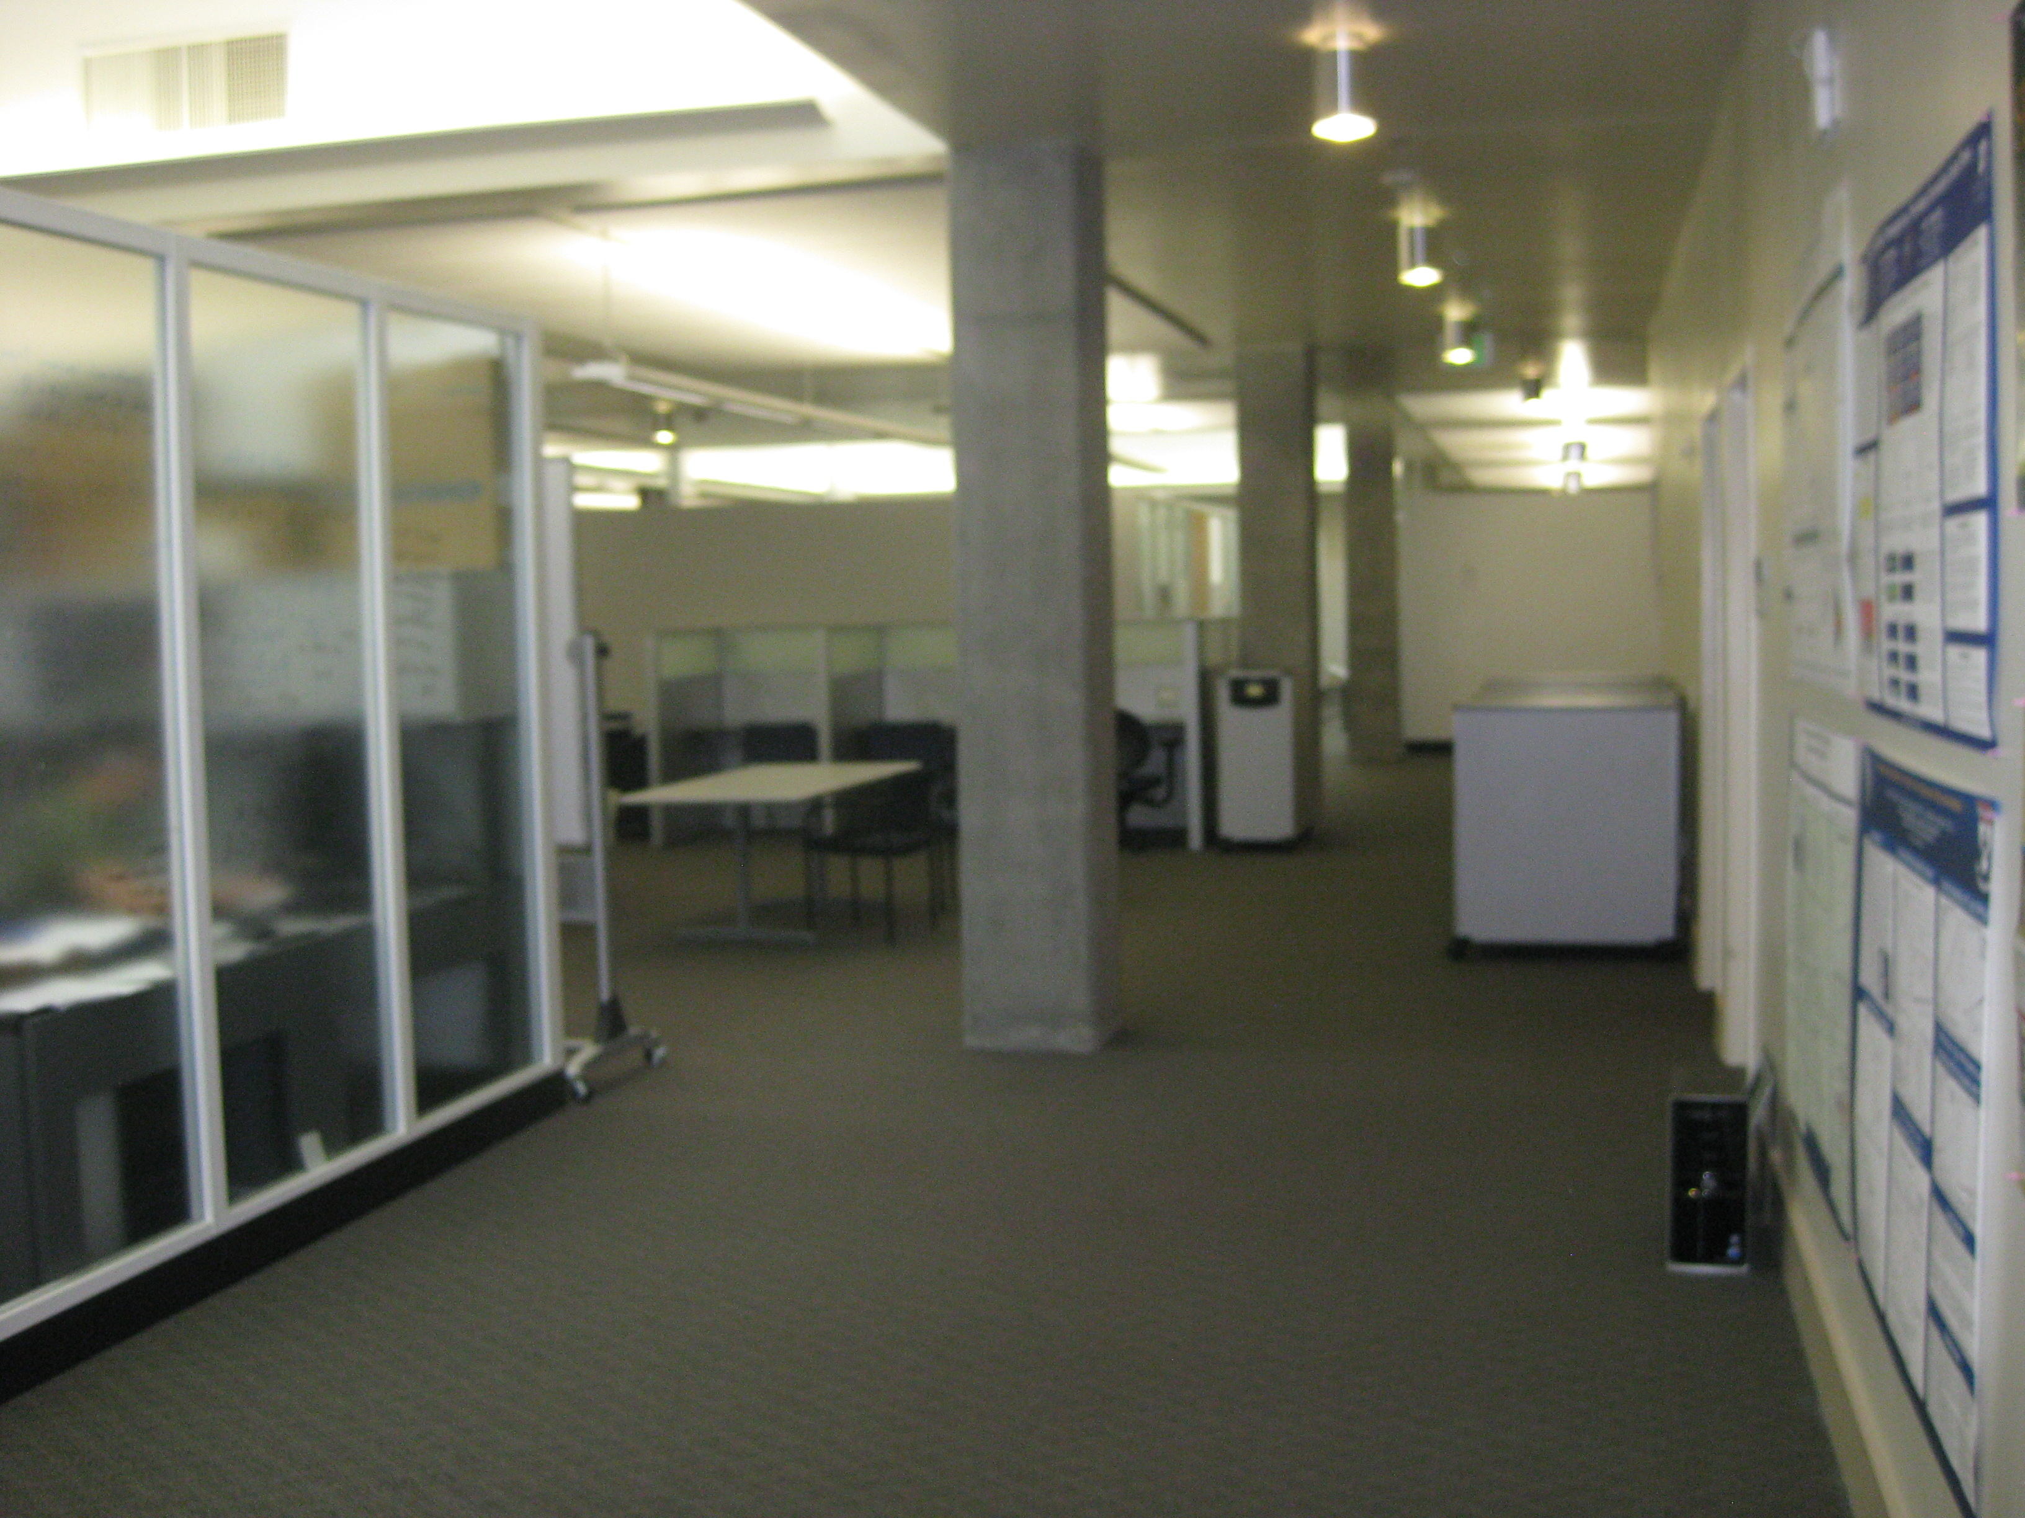
Ms. Ayik’s Office Is Upstairs

Slide 6
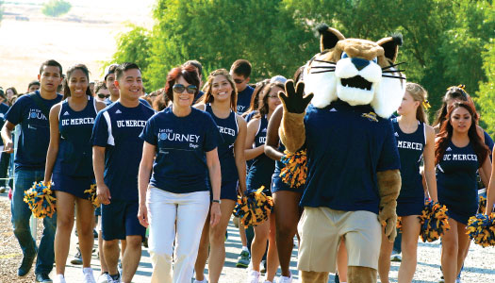
Understanding Learning Outcomes
PLOs are Program Learning Outcomes (Merritt Writing Program)
CLOs are Course Learning Outcomes. (Writing 001, Chem, Bio)
SLOs are Student Learning Outcomes. (Course specific)
Objectives are mini-goals for lessons. They help you meet all of the above learning outcomes. I write these on the board.

Slide 7

What would you like to learn in this course?
Think, pair, share.
Think: Take two to three minutes to write down what you would like to learn.
What do you want to learn in Writing 001?
Pair: Turn to the person next to you and share your list.
Share: Let’s compile a list as a class.

Slide 8
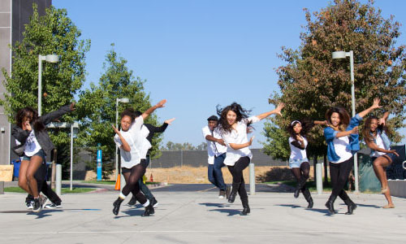
Lessons for Day 1
PowerPoint Time Management and Procrastination
Short video on time management and goal setting

